Slide 1



UPCOMING WEBINARS
MARCH 25
Millennials: Breaking the myths of this
"no strings attached" generation
APRIL 29
Marketing to Multicultural Consumers
Visit our Webinars & Events page on Nielsen.com to find out more.

Slide 2

Super Consumers
…Chapter 2
Mass and precision Marketing Activation
March 18, 2014

Slide 3

JOIN THE CONVERSATION TODAY!
#
superconsumers
Nielsen
TheCambridgeGrp
@
@

Slide 4

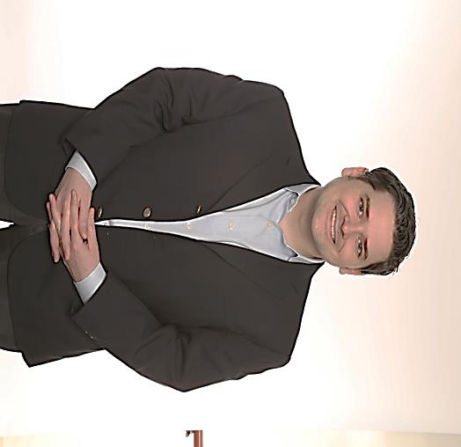
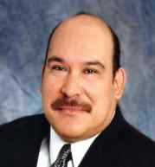
Presentation Speakers
EDDIE YOON
Principal
The Cambridge Group
CHRIS FOSDICK Principal
The Cambridge Group
JESS AGUIRRE
Senior Vice President Research & Media Planning
Crown Media

Slide 5
Super Consumers
…Chapter 2
Mass and precision Marketing Activation
March 18, 2014

Slide 6

What we’ll cover today
SUPER CONSUMERS
WHO ARE THEY?
PRECISION & MASS
MARKETING CASE STUDIES

Slide 7
Poll #1
Which best describes your Super Consumer fact-base? (Check the option that best applies.)
I know my Super Consumers and what they care about
I know how my partners’ Super Consumers overlap with mine
I know how to find and reach my Super Consumers
I have Super Consumer insights my competitors don’t
I can activate my Super Consumer insights with high ROI
I’m still exploring Super Consumers as an idea

Slide 8
who are they?
A BRIEF refresher

Slide 9
SUPER CONSUMERS ARE:
A simple idea—easy to explain and align on
A speedier path to super insights and strategy
A way to synchronize insight, strategy and activation

Slide 10

THEY ARE HIGH PROFIT AND PASSION CONSUMERS
HEAVY
USER
SUPER
CONSUMERS
HEAVILY ENGAGED
PROFITS
PASSION
The Tip of the Spear
for opportunities…
…and the Canary in the
Coal Mine for threats

Slide 11
ALL STAKEHOLDERS CAN ALIGN AROUND THEM
THE ECONOMICS OF SUPER CONSUMERS
Category Households
Category
Sales
Category Growth
Category Profit
~10%
~30%
~40%
~50-60%

Slide 12
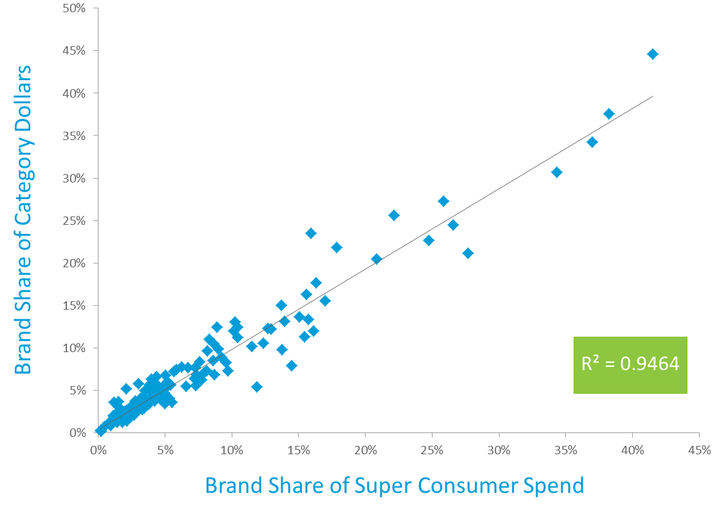
YOU CAN’T WIN WITHOUT THEM
Source: Nielsen

Slide 13




THEY DRIVE SUPERIOR INSIGHTS FOR BRANDS

Slide 14
THEY HELP MAXIMIZE STRATEGY, GROWTH & ROI
?
Growth
Strategy
Switchers
Incremental Revenue/Profit per HH
Potentials
Insights for
Marketing, Sales
& Innovation
Insights to Optimize
ROI and
Resource Allocation
SUPER CONSUMERS
# of Category Households

Slide 15
THEY ARE IMPORTANT TO YOUR TRADE PARTNERS
A SUPER CONSUMER IN ONE CATEGORY …
… IS A SUPER CONSUMER IN AN AVERAGE OF 9 ADDITIONAL CATEGORIES

Slide 16
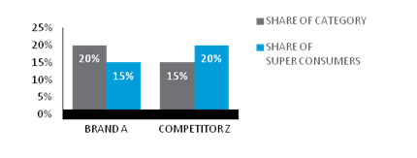
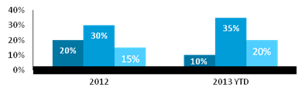
NEW WAYS FOR YOU TO QUANTIFY THE VALUE OF SUPER CONSUMERS
      FACT-BASE
      PERFORMANCE
=> 10%
        => 50%
SUPER
CONSUMERS
        They view the category as not just food,
        but as entertainment and education
      RESOURCE ALLOCATION
      KEY DECISIONS
        Focus marketing dollars
        Pull back on trade promotion
        Focus on closing distribution gaps
SUPER
CONSUMERS
MARKETING $ HIT SUPER CONSUMERS
TRADE $ HIT SUPER CONSUMERS
TOTAL POINTS OF DISTRIBUTION GAP WITH KEY
SUPER CONSUMER MARKETS
CATEGORY A

Slide 17
PRECISION AND MASS MARKETING
CASE STUDIES
 

Slide 18
Poll #2
Which describes your Super Consumer action plan?
(Check the option that best applies.)
I have a mass marketing Super Consumer action plan
I have a precision marketing Super Consumer action plan
I have both a mass and precision Super Consumer action plan
I have neither

Slide 19
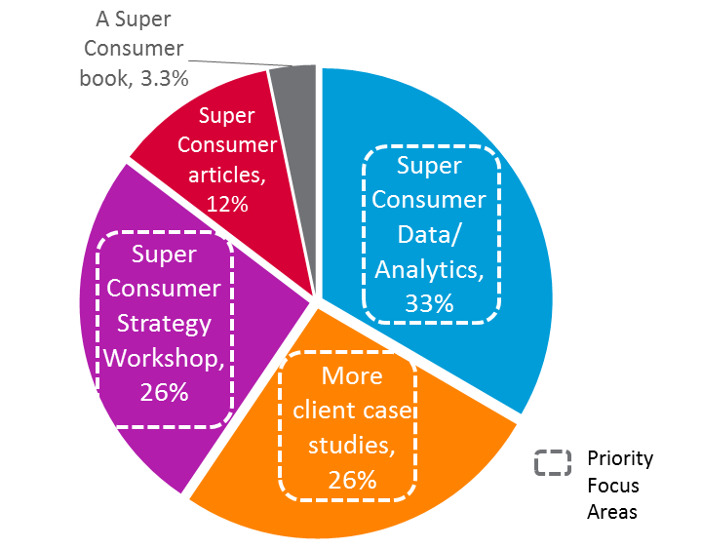
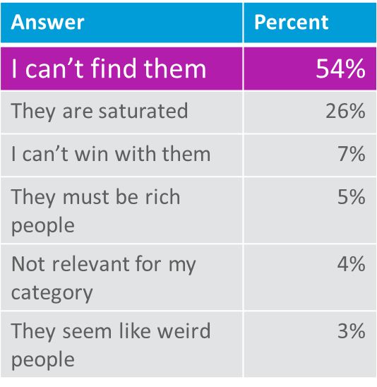
THE top ISSUE: How to find them
Q: WHAT WOULD BE MOST
HELPFUL TO YOU?
Q: WHAT CONCERNS YOU ABOUT SUPER CONSUMERS?

Slide 20
Two distinct cases:
A consumer durables company used Super Consumers to make precision marketing more impactful
A media company used Super Consumers to make mass media efforts more precise

Slide 21
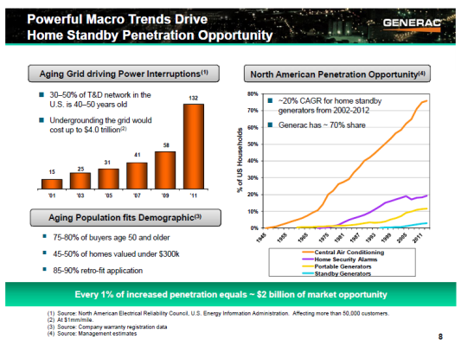
Generac is solving a $4t issue with low awareness

Slide 22

Marketing was previously very technical
Before

Slide 23


They Let SUPER CONSUMERS DO THEIR MARKETING
After

Slide 24
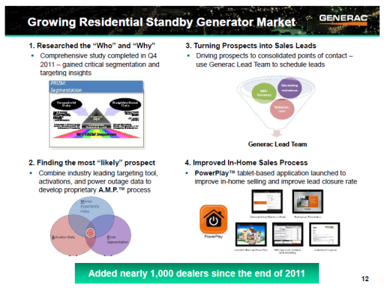
They built IP for a precision marketing process
Converting sales from reactive to proactive!

Slide 25

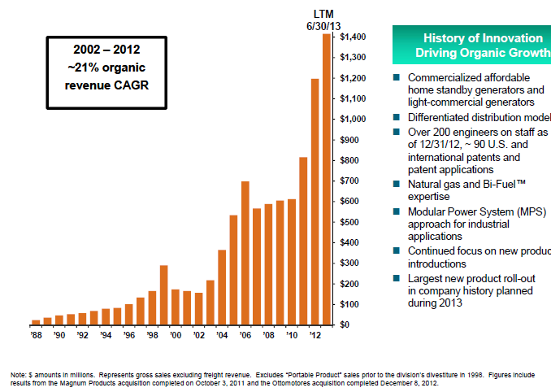
It has helped them drive their success!

Slide 26
Two distinct cases:
A consumer durables company used Super Consumers to make precision marketing more impactful
A media company used Super Consumers to make mass media efforts more precise

Slide 27

Crown Media saw an interesting opportunity to improve media buying…
SUPER CONSUMERS
Opportunity to add value (and ad effectiveness) to brand partners
CROWN MEDIA VIEWER INSIGHTS

Slide 28
…and do some myth busting
1
MYTH: All GRPs are equal, so the goal is to reach the largest audience
REALITY: There is greater value in GRPs that reach the most passionate super consumers who drive 50%+ of category profit
2
MYTH: Demographics are the most effective way to allocate spend
REALITY: Prioritizing channels that Super Consumers watch is an effective way to reach the most valuable consumers
3
MYTH: A Super Consumer approach would be impossible to activate
REALITY: New big data tools make it possible to find Super Consumers – and connect with them in a rich environment

Slide 29






core idea: AN Opportunity to improve Media buying
Claimed /
Syndicated
“Proxy” or best fit:
Women 25-54
Women 25-54 (GRPs)
Note: ~half of brand volume typically outside the demo
Improvements vs. last year
DEMOGRAPHIC
APPROACH
+
/
-
BRAND
VOLUME
DEMO
VOLUME
vs. last year
PURCHASE
BEHAVIOR
MEDIA
PRIORITY
MEDIA
METRIC
SUCCESS
METRIC
Actual
Actual Brand/Category Super Consumers
Super Consumer Brand Rating Points (BRPS)
Improved GRPs for Super Consumers
SUPER
CONSUMER
APPROACH

Slide 30
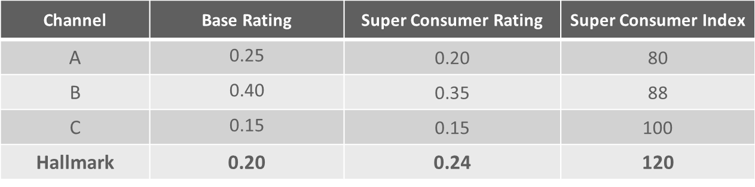
Nielsen catalina solutions provided key data
WHAT IS A RATING?
WHAT IS A SUPER CONSUMER RATING?
WHAT IS A SUPER CONSUMER INDEX?
1.0 Base Rating
1.5
Super Consumer Rating
1.5/1.0 = 150 Super Consumer Index
% of HH
a program
or channel reaches
  % of a brand’s
  Super Consumers
  the program/channel reaches
  Concentration of brand
  Super Consumers…
  Identifies the best fishing ponds to reach the most profitable buyers
Example:
Source: Nielsen Catalina Solutions; TCG Analysis
C:\Users\kohner01\AppData\Local\Microsoft\Windows\Temporary Internet Files\Content.Outlook\HBIRBNVT\Velveeta Qualitative Insights (DRAFT 5-21).pptx

Slide 31
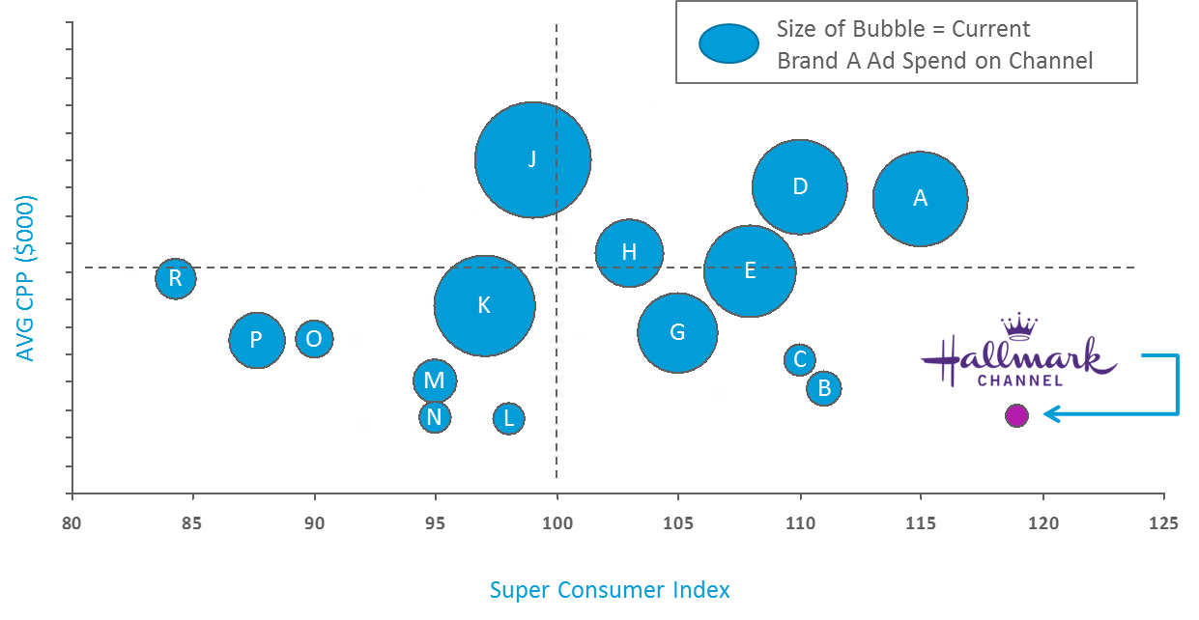
…to identify optimization opportunities …
CPG BRAND A - Super Consumer Index and CPP by Channel
(CPP $000; Super Consumer Index = SC Rating/Base Rating)
Note: CPP is projected by averaging GRPs and spend across all cable advertising spend during the time period;
Source: Nielsen Catalina Solutions; TCG Analysis

Slide 32
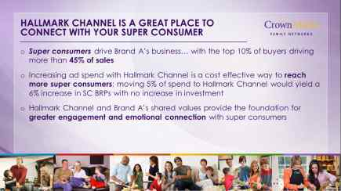
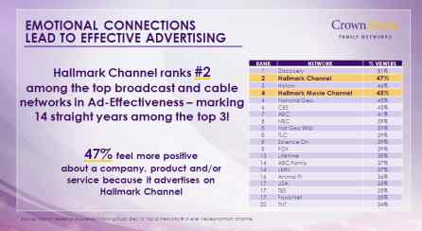
…and improve reach and resonance with a brand’s most profitable consumers
Source: Crown Media

Slide 33
Thank you

Slide 34
Poll #3
What case studies are you most interested in next?
Marketing to Super Consumers
Innovating with Super Consumers
Digital strategy with Super Consumers
Retail/Sales/Local strategy with Super Consumers
Vertical specific SC cases (e.g., media, financial services)
Integrated business planning tools for Super Consumers

Slide 35


Stay part of the Conversation!
Read our latest thinking in Harvard Business Review, the article entitled “Make Your Best Customers Even Better” in the March 2014 edition
We’ll register you as part of our Super Consumer Circle by emailing us at superconsumers@thecambridgegroup.com
Be among the first to see the latest in research, trends and RESULTS that are being realizing with Super Consumers
Gain easy access to the next 2-3 Harvard Business Review blogs, articles and potential books
Engage with our Super Consumer thought leaders to
ask questions and make suggestions for improvements

Slide 36


Q & A
THANK YOU FOR JOINING US
If you have follow-up questions or want more information, please contact your Nielsen Professional Services rep
If you are not a current Nielsen client, please contact us
  Phone: 800.553.3727
  Email: superconsumers@thecambridgegroup.com
If you have any questions regarding the content of this webinar, you can also contact Eddie Yoon:
Eddie.Yoon@nielsen.com
www.linkedin.com/pub/eddie-yoon/2/353/a82
@EddieYoonTCG
@TheCambridgeGrp
Notes:
36

